Slide 1
Elementary, My Dear Watson:
An Undergraduate Comic Books Course Using Enterprise AI and TEI
2019 Digital Initiatives Symposium
April 30, 2019
Brian Flota
Steven W. Holloway
James Madison University Libraries

Slide 2
Origins of Course
Donation of comic book collection in 2015
Participation in Digital Humanities and Social Sciences Institute (see next slide)
Proposal of course as a Summer leave project
LOTS of reading and goofing around with tech
Collaboration with Educational and Instructional Technologists
Attribution-NonCommercial-ShareAlike 4.0 International (CC BY-NC-SA 4.0)

Slide 3
State of DH at JMU
There is no “center” or official home for DH at JMU nor are there any specific graduate courses
Six-week symposia for faculty, formerly the Digital Humanities and Social Sciences Institute, recently re-branded as Networked Humanities, exists
This results in many un-unified satellite projects and infrastructures for such projects to be assisted
Attribution-NonCommercial-ShareAlike 4.0 International (CC BY-NC-SA 4.0)

Slide 4
Challenges
Create a non-coding requirement class that succeeds in DH Moderate, entails the academic study of North American comic books and graphic novels, and doesn't get us fired
Attribution-NonCommercial-ShareAlike 4.0 International (CC BY-NC-SA 4.0)

Slide 5
Goals of course
Introduce students to the history of North American comic books and to Comic Studies
Also introduce students to the collection of single-issue comic books in JMU Libraries’ Special Collections
In-depth study of a few canonized graphic novels via technology-assisted close readings
Emphasis on the craft of characterization in comic books
Understanding of copyright & trademark as it relates to comic books research
Intro to DH teamwork
Intro to simple and extended comic book annotation
Intro to a variety of non-coding tools that deepen student understanding of the subject matter
Stealth TEI/CBML markup of a comic book
Some understanding of current trends in computer-assisted comic books research
Attribution-NonCommercial-ShareAlike 4.0 International (CC BY-NC-SA 4.0)

Slide 6
Course github pages with guides, text extracts, code
https://stevenholloway.github.io/ComicBooksCourse.github.io/
Attribution-NonCommercial-ShareAlike 4.0 International (CC BY-NC-SA 4.0)

Slide 7
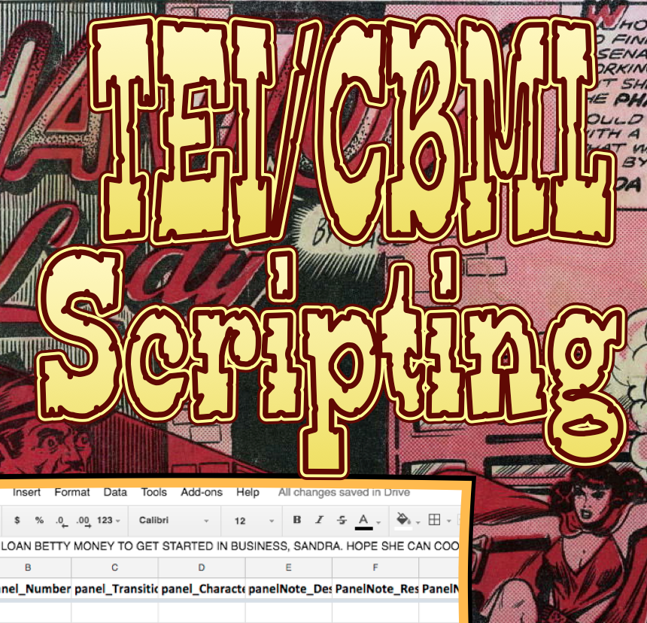
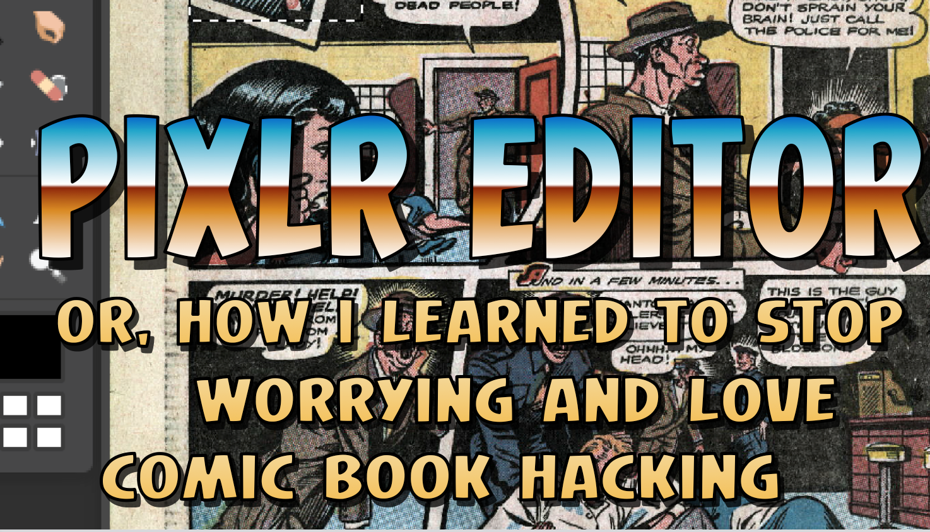

ComicLife guides for all tools
Attribution-NonCommercial-ShareAlike 4.0 International (CC BY-NC-SA 4.0)

Slide 8
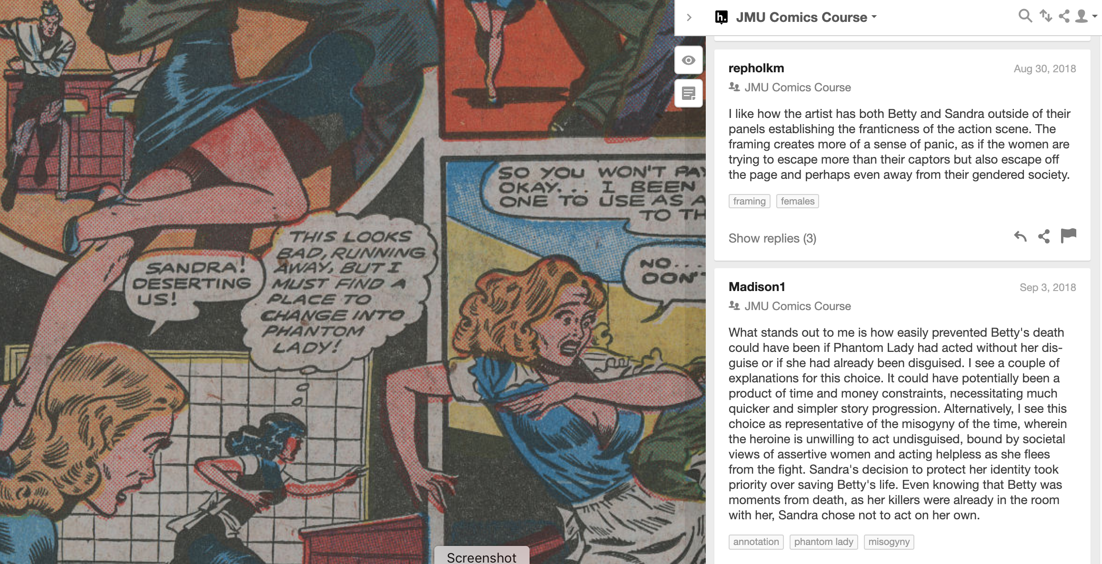
Tools for image analysis
Hypothes.is
Used for annota-
ting a comic book
in the public
domain
(Phantom Lady #17
In the Digital
Comic Museum)
Attribution-NonCommercial-ShareAlike 4.0 International (CC BY-NC-SA 4.0)

Slide 9
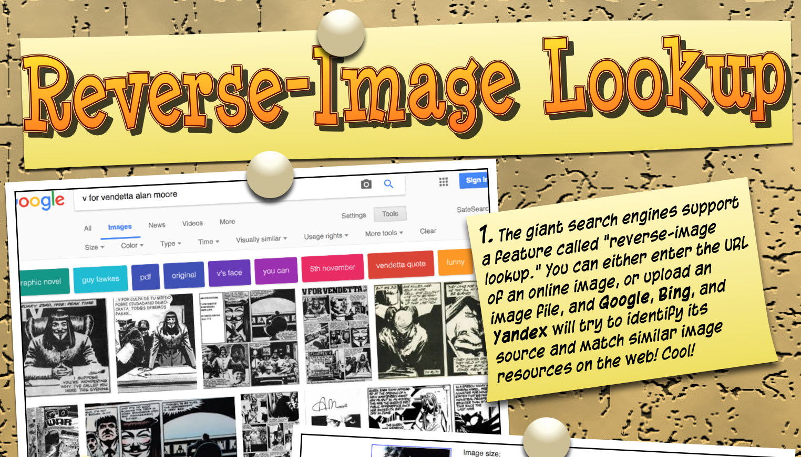
Tools for image analysis
Commercial search engine reverse lookups
Tailor-made
for illustrating
search-
engine bias
Attribution-NonCommercial-ShareAlike 4.0 International (CC BY-NC-SA 4.0)

Slide 10
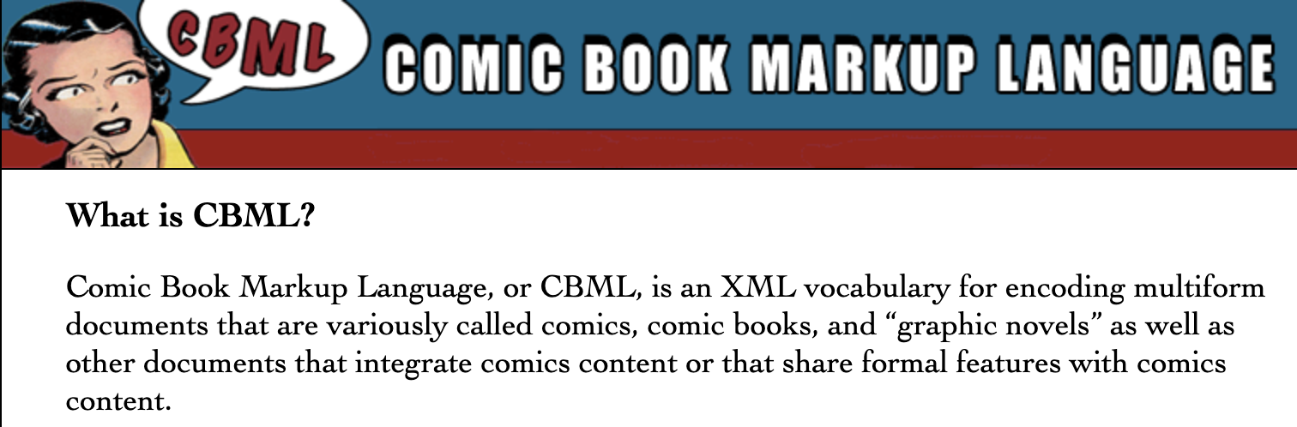
Tools for image analysis
TEI/CBML, using Google Sheets
Attribution-NonCommercial-ShareAlike 4.0 International (CC BY-NC-SA 4.0)

Slide 11
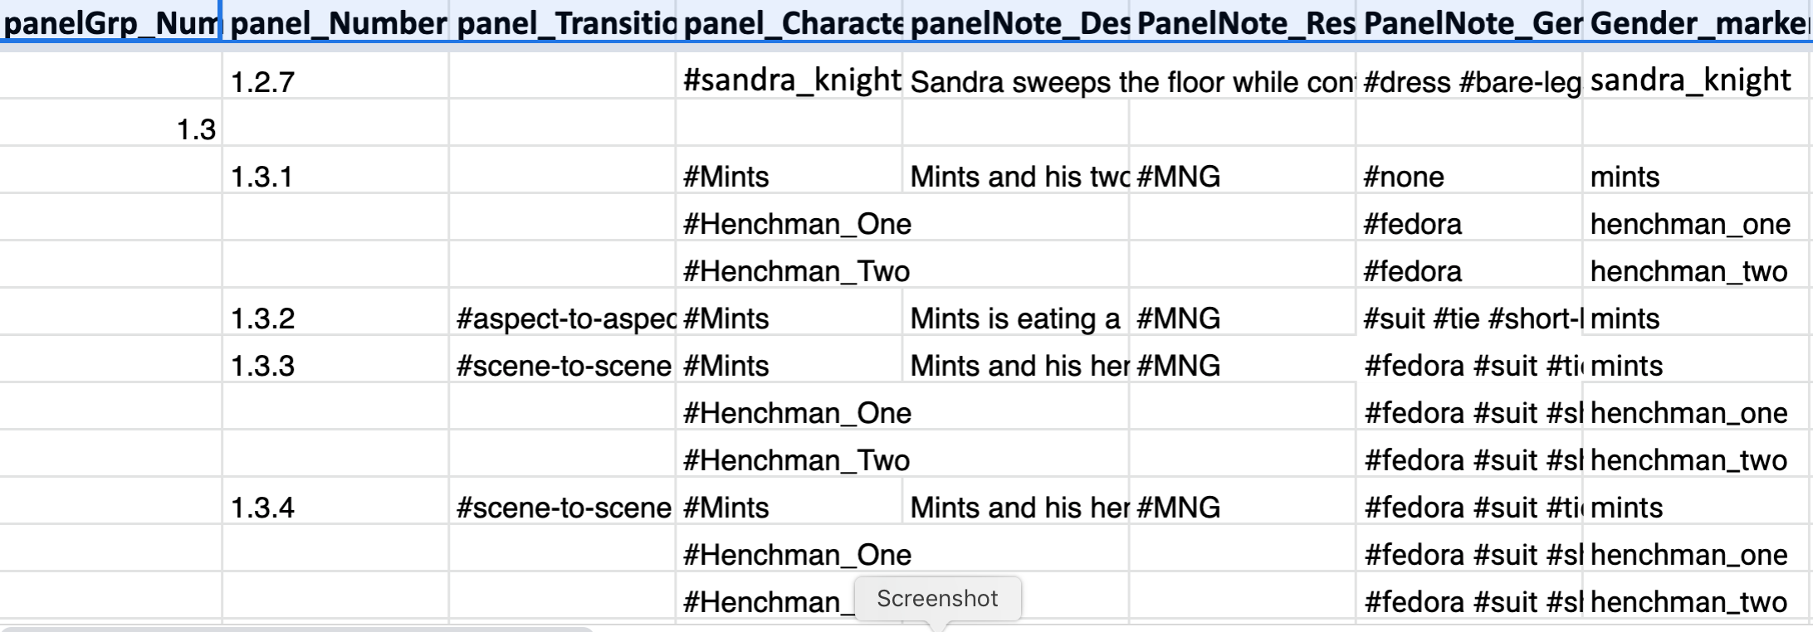
Tools for image analysis
TEI/CBML, using Google Sheets
Attribution-NonCommercial-ShareAlike 4.0 International (CC BY-NC-SA 4.0)

Slide 12
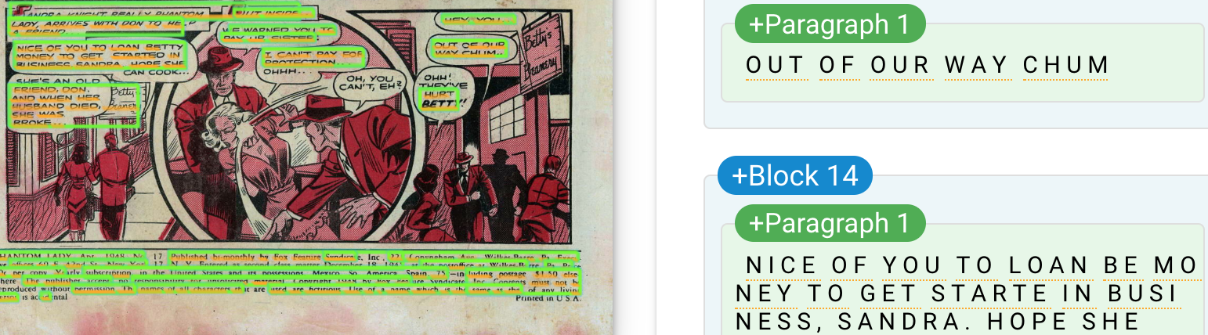
Tools for text analysis
Google Cloud Vision AI for OCRing text
Attribution-NonCommercial-ShareAlike 4.0 International (CC BY-NC-SA 4.0)

Slide 13
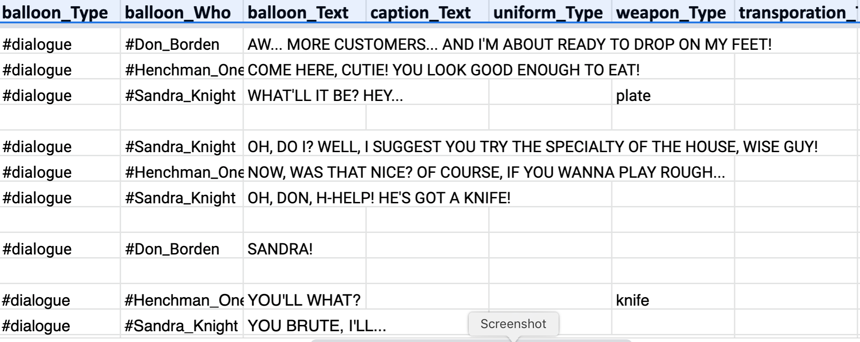
Tools for text analysis
TEI/CBML: NoSQL database, XQuery scripting
Attribution-NonCommercial-ShareAlike 4.0 International (CC BY-NC-SA 4.0)

Slide 14
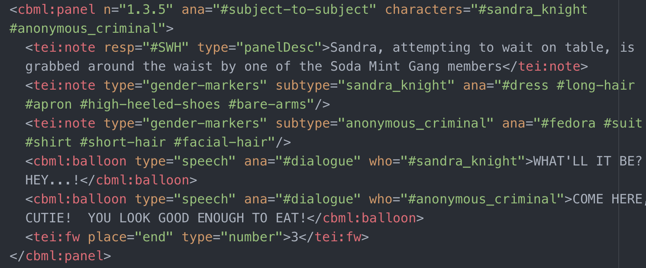
Tools for text analysis
TEI/CBML: NoSQL database, XQuery scripting
Attribution-NonCommercial-ShareAlike 4.0 International (CC BY-NC-SA 4.0)

Slide 15
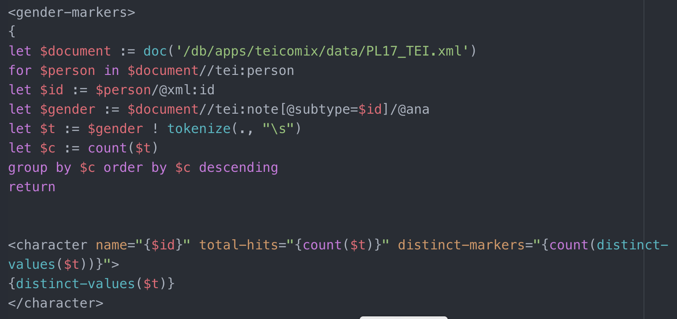
Tools for text analysis
TEI/CBML: NoSQL database, XQuery scripting
Attribution-NonCommercial-ShareAlike 4.0 International (CC BY-NC-SA 4.0)
Notes:
DEMO:

Slide 16
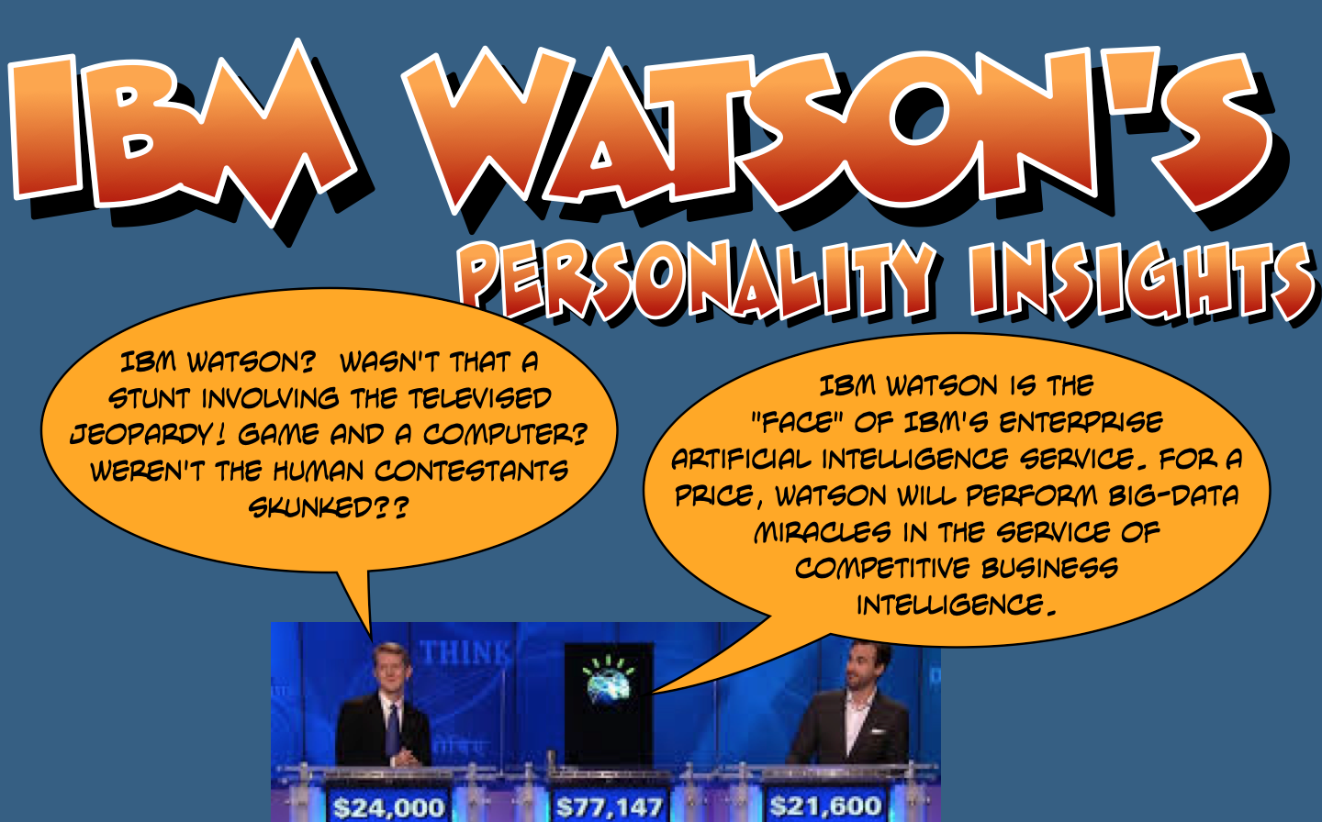
Tools for text analysis
Attribution-NonCommercial-ShareAlike 4.0 International (CC BY-NC-SA 4.0)
Notes:
DEMO:

Slide 17
Tools for text analysis
Final Course Text Mining Project: Compare Criminal Slang in Phantom Lady #17 and Batman: The Dark Knight Returns
The criminals in Phantom Lady #17, stories 1-3, and the mutants in Batman: The Dark Knight Returns, communicate through distinctive vocabularies/jargon and syntactic constructions. This project will explore the secondary literature on criminal slang or cant of the 1940s and 1980s, and will use one or more of the text corpora tools like Voyant or TAPoRware for machine text analysis. Your team will extract ALL of the text spoken by crooks in PL#17, stories 1-3, and the mutants in BTDKR (double-keying or OCR, your call), and then run it through these tools.
Attribution-NonCommercial-ShareAlike 4.0 International (CC BY-NC-SA 4.0)
Notes:
Normally better than Ambien for inducing deep, refreshing sleep, text-mining + criminal slang analysis was a hit & produced the best final project

Slide 18
questions???
Email:
DR. BRIAN FLOTA (flotabc@jmu.edu)
Dr. Steven W. Holloway (hollowsw@jmu.edu)
Course Github pages:
https://stevenholloway.github.io/ComicBooksCourse.github.io/
Attribution-NonCommercial-ShareAlike 4.0 International (CC BY-NC-SA 4.0)

